Slide 1
Chapter 4: Threads

Slide 2
Chapter 4: Threads
Overview
Multicore Programming
Multithreading Models
Thread Libraries
Threading Issues
Operating System Examples

Slide 3
Threads
Despite of the fact that a thread must execute in process, the process and its associated threads are different concept. Processes are used to group resources together and threads are the entities scheduled for execution on the CPU.
A thread is a single sequence stream within in a process. Because threads have some of the properties of processes, they are sometimes called lightweight processes.

Slide 4
Threads
In a process, threads allow multiple executions of streams. In many respect, threads are popular way to improve application through parallelism.
The CPU switches rapidly back and forth among the threads giving illusion that the threads are running in parallel.
Like a traditional process i.e., process with one thread, a thread can be in any of several states (Running, Blocked, Ready or Terminated).

Slide 5
Threads
. A thread has or consists of:
  a program counter (PC),
  a register set, and
  a stack space.
Threads are not independent of one other like processes as a result threads shares with other threads their code section, data section, OS resources, open files and signals.

Slide 6
Processes Vs Threads
Threads operate in the same way as that of processes. Some of the similarities and differences are:
Similarities
  Like processes threads share CPU and only one thread active (running) at a time.
  Like processes, threads within a processes execute sequentially.
  Like processes, thread can create children.
  And like process, if one thread is blocked, another thread can run.

Slide 7
Processes Vs Threads
Differences
  Unlike processes, threads are not independent of one another.
  Unlike processes, all threads can access every address in the task .
  Unlike processes, thread are design to assist one other.
Note that processes might or might not assist one another because processes may originate from different users.

Slide 8
Why Threads?
Following are some reasons why we use threads in designing operating systems.
  A process with multiple threads make a great server for example printer server.
  Because threads can share common data, they do not need to use inter-process communication.
  Because of the very nature, threads can take advantage of multiprocessors.

Slide 9
Why Threads?
Threads are cheap in the sense that
  Threads are cheap to create.
  Threads use very little resources of an operating system in which they are working.
    Threads do not need new address space, global data, program code or operating system resources.
  Context switching are fast when working with threads. The reason is that we only have to save and/or restore PC, SP and registers.
But this cheapness does not come free - the biggest drawback is that there is no protection between threads.

Slide 10
Motivation
Most modern applications are multithreaded
Threads run within application
Multiple tasks with the application can be implemented by separate threads
  Update display
  Fetch data
  Spell checking
  Answer a network request
Can simplify code, increase efficiency
Kernels are generally multithreaded

Slide 11
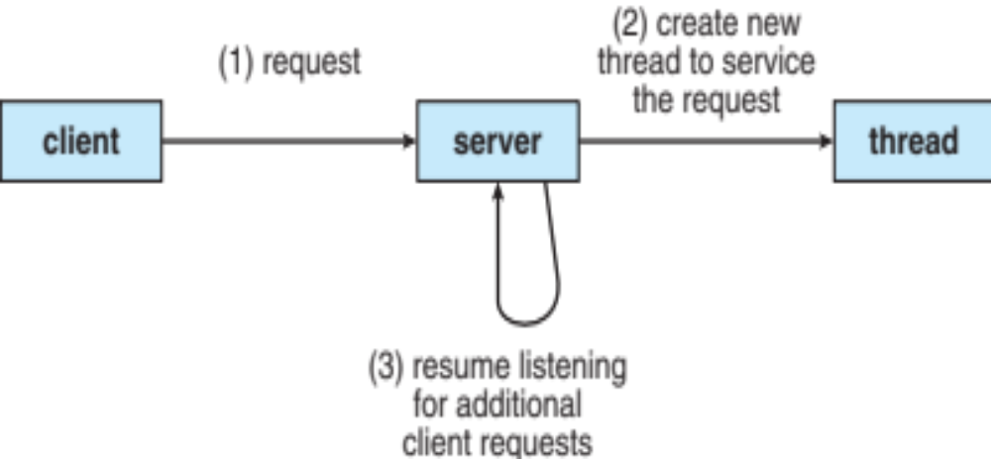
Multithreaded Server Architecture

Slide 12
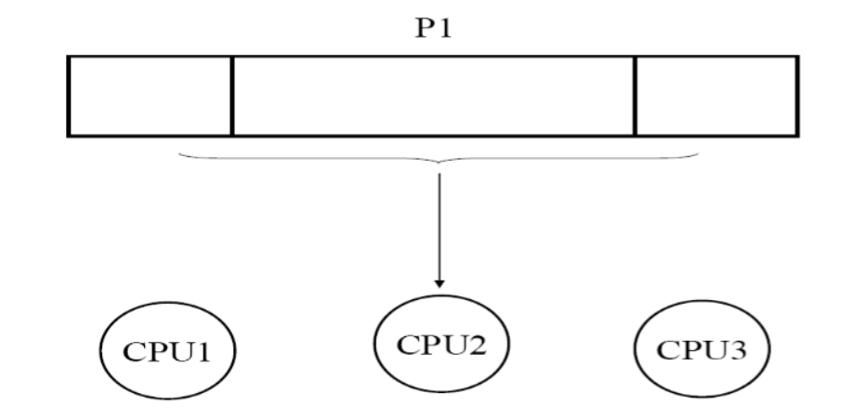
Threads
A process with only one thread can use only one CPU at a time

Slide 13
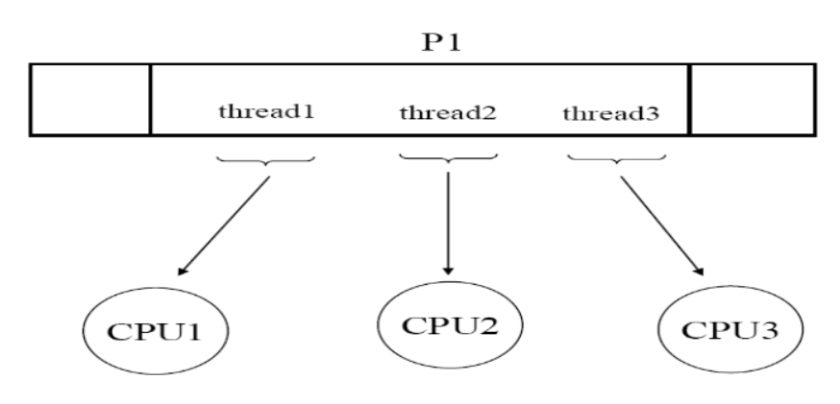
Threads
A process with several threads can use several CPUs at a time

Slide 14
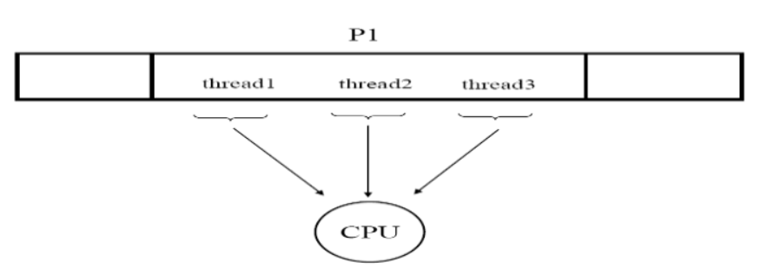
Threads
A process with several threads can use one CPU more effectively

Slide 15
Benefits
Responsiveness – may allow continued execution if part of process is blocked, especially important for user interfaces
Resource Sharing – threads share resources of process, easier than shared memory or message passing
Economy – cheaper than process creation, thread switching lower overhead than context switching
Scalability – process can take advantage of multiprocessor architectures

Slide 16

Single and Multithreaded Processes

Slide 17
Quiz
Provide two programming examples of multithreading giving improved performance over a single-threaded solution.
Provide two programming examples of multithreading that would not improve performance over a single - threaded solution.

Slide 18
Quiz answer
(1) A Web server that services each request in a separate thread. (2) A parallelized application such as matrix multiplication where different parts of the matrix may be worked on in parallel. (3) An interactive GUI program such as a debugger where a thread is used to monitor user input, another thread represents the running application, and a third thread monitors performance.
(1) Any kind of sequential program is not a good candidate to be threaded. An example of this is a program that calculates an individual tax return. (2) Another example is a ”shell” program such as the C-shell or Kornshell. Such a program must closely monitor its own working space such as open files, environment variables, and current working directory.

Slide 19
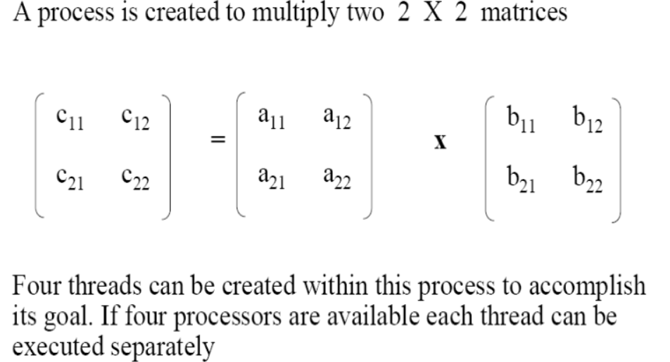
Thread application

Slide 20
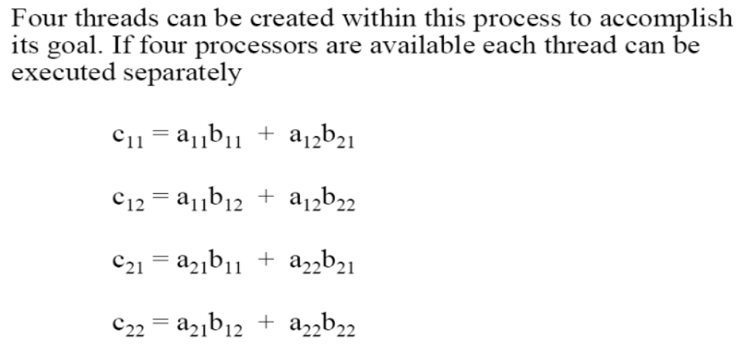
Thread application

Slide 21
Multicore Programming
Multicore or multiprocessor systems putting pressure on programmers, challenges include:
  Dividing activities
  Balance
  Data splitting
  Data dependency
  Testing and debugging
Parallelism implies a system can perform more than one task simultaneously
Concurrency supports more than one task making progress

Slide 22
Multicore Programming (Cont.)
Types of parallelism
  Data parallelism – distributes subsets of the same data across multiple cores, same operation on each
  Task parallelism – distributing threads across cores, each thread performing unique operation
As # of threads grows, so does architectural support for threading
  CPUs have cores as well as hardware threads
  Consider Oracle SPARC T4 with 8 cores, and 8 hardware threads per core

Slide 23


Concurrency vs. Parallelism
Concurrent execution on single-core system:
Parallelism on a multi-core system:

Slide 24

Amdahl’s Law
Identifies performance gains from adding additional cores to an application that has both serial and parallel components
  S is serial portion
  N processing cores
That is, if application is 75% parallel / 25% serial, moving from 1 to 2 cores results in speedup of 1.6 times
As N approaches infinity, speedup approaches 1 / S
Serial portion of an application has disproportionate effect on performance gained by adding additional cores

Slide 25
User Threads and Kernel Threads
User threads - management done by user-level threads library
Three primary thread libraries:
  POSIX Pthreads
  Windows threads
  Java threads
Kernel threads - Supported by the Kernel
Examples – virtually all general purpose operating systems, including:
  Windows
  Solaris
  Linux
  Tru64 UNIX
  Mac OS X

Slide 26
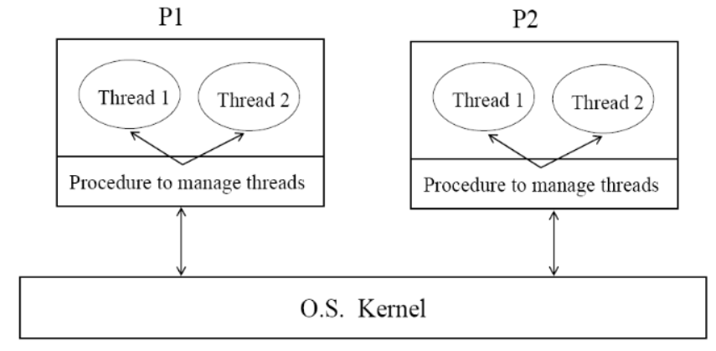
User-Level thread

Slide 27
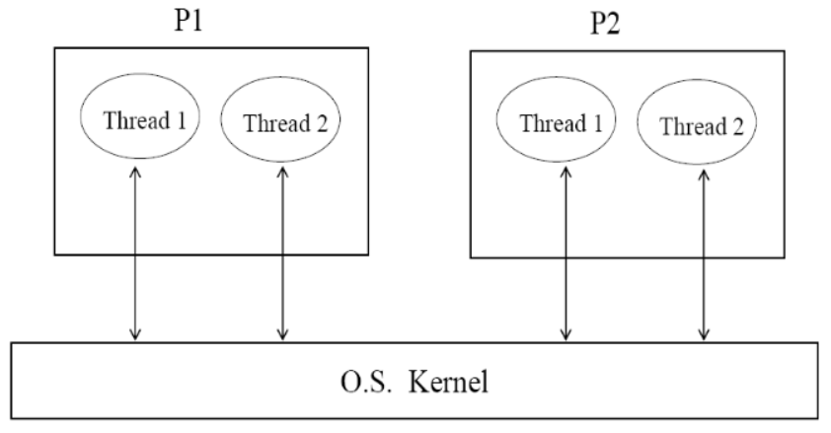
Kernel-Level thread

Slide 28
User-Level Threads
User-level threads implement in user-level libraries, In fact, the kernel knows nothing about user-level threads and manages them as if they were single-threaded processes.
Advantages:
  The most obvious advantage of this technique is that a user-level threads package can be implemented on an Operating System that does not support threads.
  User-level threads does not require modification to operating systems.
  Simple Representation: Each thread is represented simply by a PC, registers, stack and a small control block, all stored in the user process address space.
  Simple Management: This simply means that creating a thread, switching between threads and synchronization between threads can all be done without intervention of the kernel.
  Fast and Efficient: Thread switching is not much more expensive than a procedure call.

Slide 29
User-Level Threads
Disadvantages:
  There is a lack of coordination between threads and operating system kernel. Therefore, process as whole gets one time slice irrespective of whether process has one thread or 1000 threads within. It is up to each thread to relinquish control to other threads.
  User-level threads requires non-blocking systems call i.e., a multithreaded kernel. Otherwise, entire process will blocked in the kernel, even if there are runnable threads left in the processes. For example, if one thread causes a page fault, the process blocks.

Slide 30
Kernel-Level Threads
Advantages:
  Because kernel has full knowledge of all threads, Scheduler may decide to give more time to a process having large number of threads than process having small number of threads.
  Kernel-level threads are especially good for applications that frequently block.
Disadvantages:
  The kernel-level threads are slow and inefficient. For instance, threads operations are hundreds of times slower than that of user-level threads.
  Since kernel must manage and schedule threads as well as processes. It require a full thread control block (TCB) for each thread to maintain information about threads. As a result there is significant overhead and increased in kernel complexity

Slide 31
Advantages of Threads over Multiple Processes
Context Switching Threads are very inexpensive to create and destroy, and they are inexpensive to represent. It is relatively easier for a context switch using threads.
Sharing Treads allow the sharing of a lot resources that cannot be shared in process, for example, sharing code section, data section, Operating System resources like open file etc.

Slide 32
Disadvantages of Threads over Multi-Processes
Blocking The major disadvantage if that if the kernel is single threaded, a system call of one thread will block the whole process and CPU may be idle during the blocking period.
Security Since there is, an extensive sharing among threads there is a potential problem of security. It is quite possible that one thread over writes the stack of another thread (or damaged shared data) although it is very unlikely since threads are meant to cooperate on a single task.
.

Slide 33
Applications and Threads
Application that Benefits from Threads
  A proxy server satisfying the requests for a number of computers on a LAN would be benefited by a multi-threaded process. In general, any program that has to do more than one task at a time could benefit from multitasking. For example, a program that reads input, process it, and outputs could have three threads, one for each task.
Application that cannot Benefit from Threads
  Any sequential process that cannot be divided into parallel task will not benefit from thread, as they would block until the previous one completes. For example, a program that displays the time of the day would not benefit from multiple threads.

Slide 34
Multithreading Models
Many-to-One
One-to-One
Many-to-Many

Slide 35

Many-to-One
Many user-level threads mapped to single kernel thread
One thread blocking causes all to block
Multiple threads may not run in parallel on multicore system because only one may be in kernel at a time
Few systems currently use this model
Examples:
  Solaris Green Threads
  GNU Portable Threads

Slide 36

One-to-One
Each user-level thread maps to kernel thread
Creating a user-level thread creates a kernel thread
More concurrency than many-to-one
Number of threads per process sometimes restricted due to overhead
Examples
  Windows
  Linux
  Solaris 9 and later

Slide 37

Many-to-Many Model
Allows many user level threads to be mapped to many kernel threads
Allows the operating system to create a sufficient number of kernel threads
Solaris prior to version 9
Windows with the ThreadFiber package

Slide 38

Two-level Model
Similar to M:M, except that it allows a user thread to be bound to kernel thread
Examples
  IRIX
  HP-UX
  Tru64 UNIX
  Solaris 8 and earlier

Slide 39
Thread Libraries
Thread library provides programmer with API for creating and managing threads
Two primary ways of implementing
  Library entirely in user space
  Kernel-level library supported by the OS

Slide 40
Quiz
Consider a multiprocessor system and a multithreaded program written using the many-to-many threading model. Let the user-level threads in the program be more than the number of processors in the system. Discuss the performance implications of the following scenarios.
  The number of kernel threads allocated to the program is less than the number of processors
  The number of kernel threads allocated to the program is equal to the number of processors
  The number of kernel threads allocated to the program is grater than the number processors but less than the user-level threads

Slide 41
Pthreads
May be provided either as user-level or kernel-level
A POSIX standard (IEEE 1003.1c) API for thread creation and synchronization
Specification, not implementation
API specifies behavior of the thread library, implementation is up to development of the library
Common in UNIX operating systems (Solaris, Linux, Mac OS X)

Slide 42

Pthreads Example

Slide 43
Pthreads Example (Cont.)

Slide 44
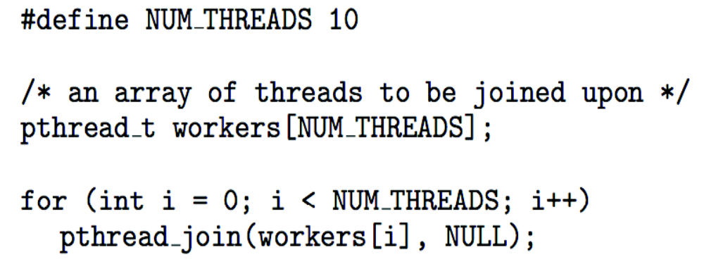
Pthreads Code for Joining 10 Threads

Slide 45

Java Threads
Java threads are managed by the JVM
Typically implemented using the threads model provided by underlying OS
Java threads may be created by:
  Extending Thread class
  Implementing the Runnable interface

Slide 46
Implicit Threading
Growing in popularity as numbers of threads increase, program correctness more difficult with explicit threads
Creation and management of threads done by compilers and run-time libraries rather than programmers
Three methods explored
  Thread Pools
  OpenMP
  Grand Central Dispatch
Other methods include Microsoft Threading Building Blocks (TBB), java.util.concurrent package

Slide 47
Threading Issues
Semantics of fork() and exec() system calls
Signal handling
  Synchronous and asynchronous
Thread cancellation of target thread
  Asynchronous or deferred
Thread pools
Thread-local storage
Scheduler Activations

Slide 48
Semantics of fork() and exec()
Does fork()duplicate only the calling thread or all threads?
  Some UNIX systems have two versions of fork
exec() usually works as normal – replace the running process including all threads

Slide 49
Signal Handling
Signals are used in UNIX systems to notify a process that a particular event has occurred.
A signal handler is used to process signals
  Signal is generated by particular event
  Signal is delivered to a process
  Signal is handled by one of two signal handlers:
    default
    user-defined
Every signal has default handler that kernel runs when handling signal
  User-defined signal handler can override default
  For single-threaded, signal delivered to process

Slide 50
Signal Handling (Cont.)
Where should a signal be delivered for multi-threaded?
  Deliver the signal to the thread to which the signal applies
  Deliver the signal to every thread in the process
  Deliver the signal to certain threads in the process
  Assign a specific thread to receive all signals for the process

Slide 51

Thread Cancellation
Terminating a thread before it has finished
Thread to be canceled is target thread
Two general approaches:
  Asynchronous cancellation terminates the target thread immediately
  Deferred cancellation allows the target thread to periodically check if it should be cancelled
Pthread code to create and cancel a thread:

Slide 52

Thread Cancellation (Cont.)
Invoking thread cancellation requests cancellation, but actual cancellation depends on thread state
If thread has cancellation disabled, cancellation remains pending until thread enables it
Default type is deferred
  Cancellation only occurs when thread reaches cancellation point
On Linux systems, thread cancellation is handled through signals

Slide 53
Thread Pools
Create a number of threads in a pool where they wait for work
Advantages:
  Usually slightly faster to service a request with an existing thread than create a new thread
  Allows the number of threads in the application(s) to be bound to the size of the pool

Slide 54
Thread-Local Storage
Thread-local storage (TLS) allows each thread to have its own copy of data
Useful when you do not have control over the thread creation process (i.e., when using a thread pool)
Different from local variables
  Local variables visible only during single function invocation
  TLS visible across function invocations
Similar to static data
  TLS is unique to each thread

Slide 55

Scheduler Activations
Both: Many and Two-level models require communication to maintain the appropriate number of kernel threads allocated to the application
Typically use an intermediate data structure between user and kernel threads – lightweight process (LWP)
  Appears to be a virtual processor on which process can schedule user thread to run
  Each LWP attached to kernel thread
  How many LWPs to create?
Scheduler activations provide upcalls - a communication mechanism from the kernel to the upcall handler in the thread library
This communication allows an application to maintain the correct number kernel threads

Slide 56
Operating System Examples
Windows Threads
Linux Threads

Slide 57
Windows Threads
Windows implements the Windows API – primary API for Win 98, Win NT, Win 2000, Win XP, and Win 7
Implements the one-to-one mapping, kernel-level
Each thread contains
  A thread id
  Register set representing state of processor
  Separate user and kernel stacks for when thread runs in user mode or kernel mode
  Private data storage area used by run-time libraries and dynamic link libraries (DLLs)
The register set, stacks, and private storage area are known as the context of the thread

Slide 58
Windows Threads (Cont.)
The primary data structures of a thread include:
  ETHREAD (executive thread block) – includes pointer to process to which thread belongs and to KTHREAD, in kernel space
  KTHREAD (kernel thread block) – scheduling and synchronization info, kernel-mode stack, pointer to TEB, in kernel space
  TEB (thread environment block) – thread id, user-mode stack, thread-local storage, in user space

Slide 59

Windows Threads Data Structures

Slide 60

Linux Threads
Linux refers to them as tasks rather than threads
Thread creation is done through clone() system call
clone() allows a child task to share the address space of the parent task (process)
  Flags control behavior
struct task_struct points to process data structures (shared or unique)

Slide 61
Questions
What are advantages and disadvantages of using user-level threads?
What are advantages and disadvantages of using kernel-level threads?
Can multithreaded solution using multiple user-level threads achieve better performance on a multiprocessor system than on a single-processor system?
Under what circumstances is better to use kernel-level threads than user-level threads?
Which of the following components of program state are shared across threads in a multithreaded process?
  Register values
  Code
  Global variables
  Stack memory

Slide 62
End of Chapter 4

